Slide 1

Estimating The Impact Of Opioid Control Policies
Alex Bzdel
Charlotte Yuan
Zhonglin Wang
Annapurna Pandita

Slide 2
TABLE OF CONTENTS
04
01
05
02
06
03
07
Data Preparation
Introduction
Data Sources
Data Cleaning Pipeline
Control States
Background
Rationale
Summary Statistics
Research Design
Before and after inclusion of opioid control policies
Pre-Post Analysis
Difference-in-Difference Analysis
Methodology
Results
Approach
Examples
Interpretation & Conclusion
Succinct overview of findings

Slide 3

01
Introduction

Slide 4
THE OPIOID EPIDEMIC BY THE NUMBERS
1.6 Million
People misused prescription pain relievers for the first time
10.1 Million
People misused prescription opioids in 2019
70,630
People died from drug overdose in 2019
Notes:
https://www.hhs.gov/opioids/about-the-epidemic/index.html

Slide 5
02
Research Design

Slide 6
AIM OF THE ANALYSIS:
Estimate the effects of opioid control policies on opioid shipments and opioid overdose deaths in Florida and Washington
Estimate the effects of opioid control policies on opioid overdose deaths in Texas
Notes:
https://www.hhs.gov/opioids/about-the-epidemic/index.html

Slide 7
Pre-Post Analysis
COMPARISON
SIMPLE
SHORTCOMINGS
State’s outcome compared to pre and post policy implementation
Comparing state only to itself - intuitive causal inference
Not robust to policy changes on a larger scale

Slide 8
Difference-in-Difference Analysis
COMPARISON
ADDS CONTEXT
We add a set of different states to compare our changes to
Do we see the same trends across comparison states?

Slide 9
03
Methodology

Slide 10
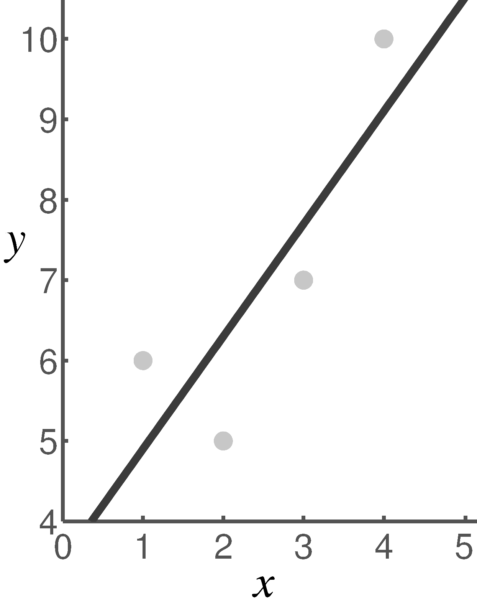
Regression Based Approach
Univariate Linear Regression
Separate trend lines - before and after policy
Able to isolate the problem and analysis

Slide 11
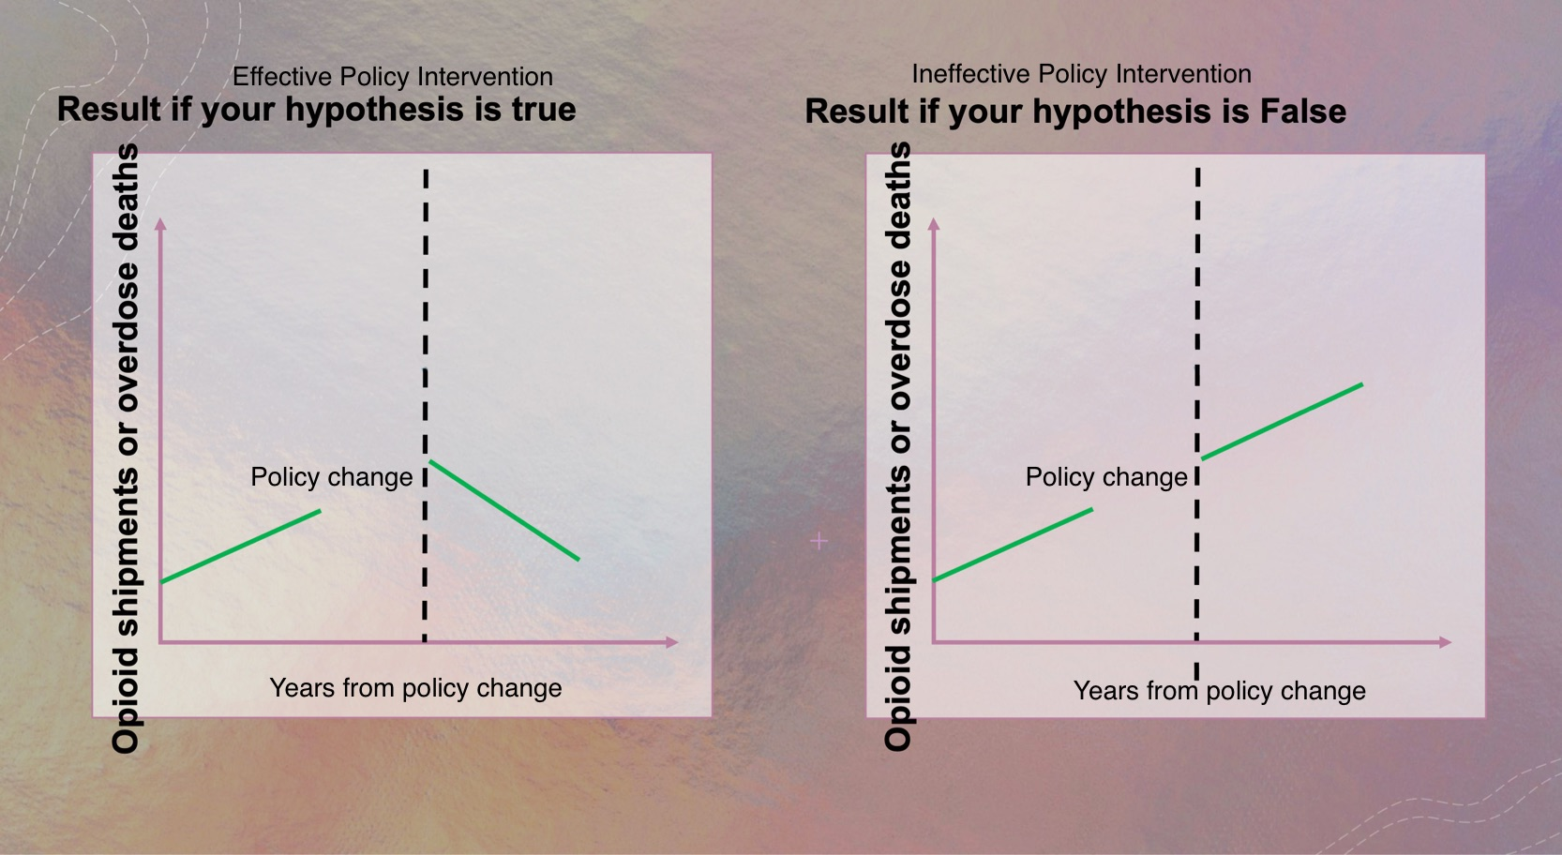
Successful Pre-Post Analysis

Slide 12
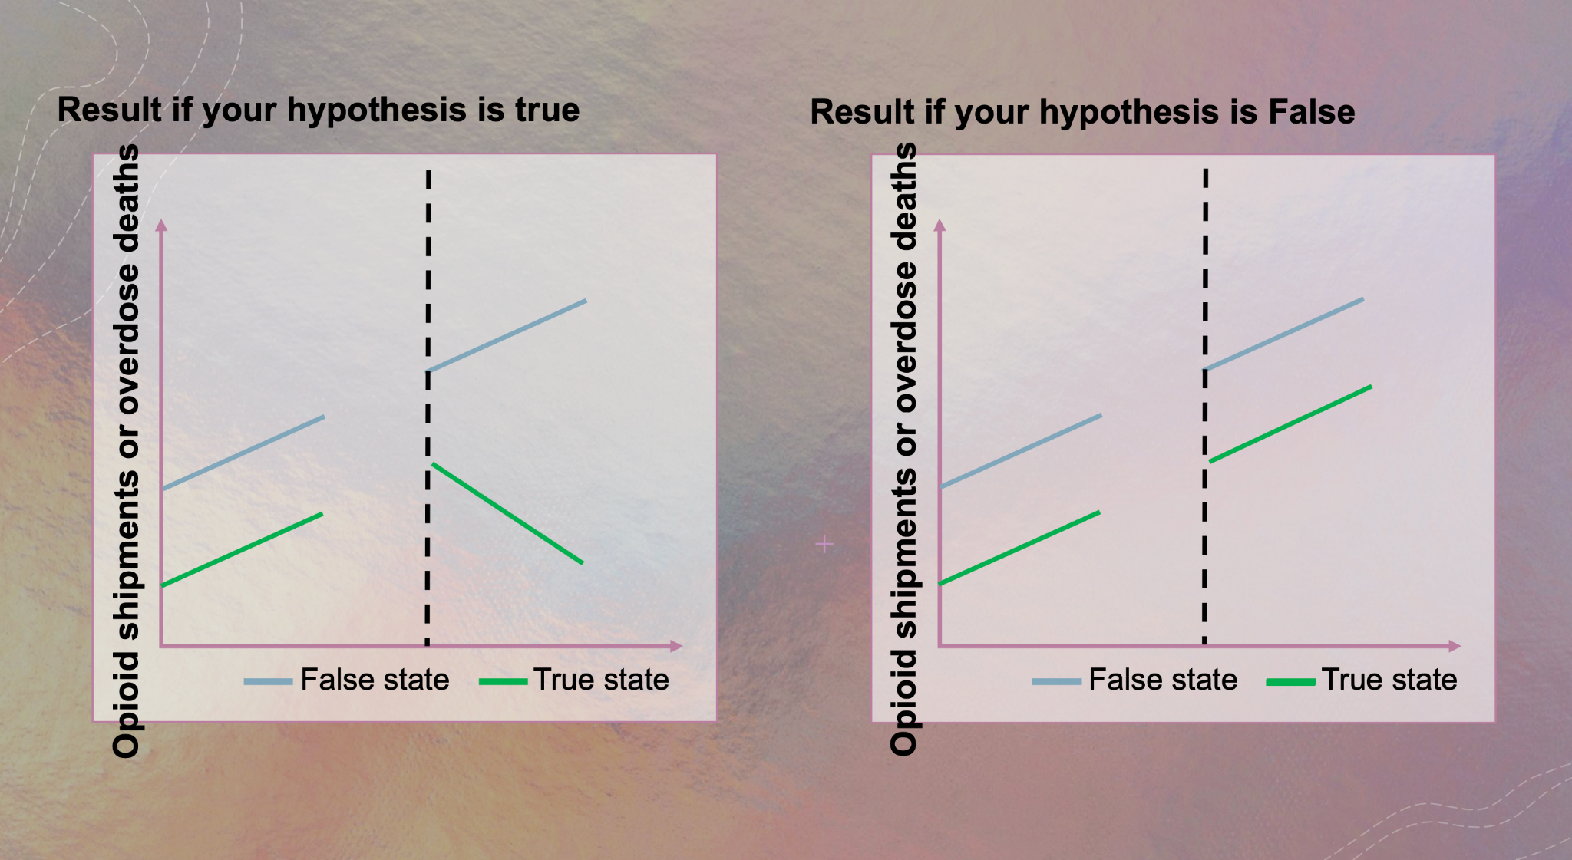
Successful Difference-In-Difference Analysis

Slide 13
04
Data Preparation

Slide 14
Data Sources
MORTALITY
SHIPMENTS
POPULATION
Vital Statistics Data - number of deaths by each year at a county level
Washington Post - opioid shipments from suppliers (2006-2014)
US Census - county populations are used to normalize data

Slide 15
Data Cleaning Pipeline
FIPS
JOIN
POPULATION
Create unique FIPS ID for each county
FIPS joined to overdose deaths and opioid shipment datasets
FIPS allows easier merge with population data
IMPUTE SHIPMENTS
IMPUTE OVERDOSES
NORMALIZE
Missing records filled in with zero
Missing records filled in with random integers (0-9)
Normalize data (overdose deaths, opioid shipments per 100k residents)

Slide 16
Control States
FLORIDA
TEXAS
WASHINGTON
Pennsylvania
Michigan
North Carolina
Massachusetts
Michigan
Illinois
Maryland
North Carolina
Colorado

Slide 17
05
Summary Statistics

Slide 18
Summary Statistics – Florida
Opioid Overdose Deaths (Per 100K Residents)
State | Relative To Policy Change | Mean | Median | Minimum | Maximum
Controls - NC,MI,PA | Before | 13.72 | 12.10 | 3.81 | 43.32
 | After | 15.40 | 14.40 | 3.78 | 62.55
Florida | Before | 15.86 | 15.55 | 4.84 | 35.88
 | After | 14.95 | 14.13 | 3.90 | 37.16

Slide 19
Summary Statistics – Florida
Opioid Shipment (MME Per 100K Residents)
State | Relative To Policy Change | Mean | Median | Minimum | Maximum
Controls - NC,MI,PA | Before | 33429.18 | 33026.10 | 30583.29 | 36678.18
 | After | 42360.75 | 42772.40 | 39345.81 | 44552.41
Florida | Before | 47322.98 | 46442.37 | 38192.19 | 57334.38
 | After | 56526.93 | 56633.96 | 39785.73 | 73054.09

Slide 20
Summary Statistics – Texas
Opioid Overdose Deaths (Per 100K Residents)
State | Relative To Policy Change | Mean | Median | Minimum | Maximum
Controls - MI,MA,IL | Before | 9.41 | 8.95 | 8.32 | 10.95
 | After | 11.88 | 11.94 | 11.29 | 12.36
Texas | Before | 10.05 | 9.22 | 8.10 | 12.83
 | After | 10.55 | 10.48 | 9.68 | 11.56

Slide 21
Summary Statistics – Washington
Opioid Overdose Deaths (Per 100K Residents)
State | Relative To Policy Change | Mean | Median | Minimum | Maximum
Controls - CO,MD,NC | Before | 14.17 | 14.17 | 12.51 | 15.82
 | After | 15.55 | 14.81 | 13.80 | 18.77
Washington | Before | 13.49 | 14.17 | 12.02 | 14.28
 | After | 13.80 | 13.77 | 13.31 | 14.35

Slide 22
Summary Statistics – Washington
Opioid Shipment (MME Per 100K Residents)
State | Relative To Policy Change | Mean | Median | Minimum | Maximum
Controls - CO,MD,NC | Before | 39837.53 | 40158.80 | 36133.56 | 43220.23
 | After | 44158.75 | 44259.06 | 43536.10 | 44681.09
Washington | Before | 76808.29 | 77468.98 | 75058.20 | 77897.69
 | After | 77487.65 | 77489.84 | 77317.16 | 77655.94

Slide 23
06
Results

Slide 24
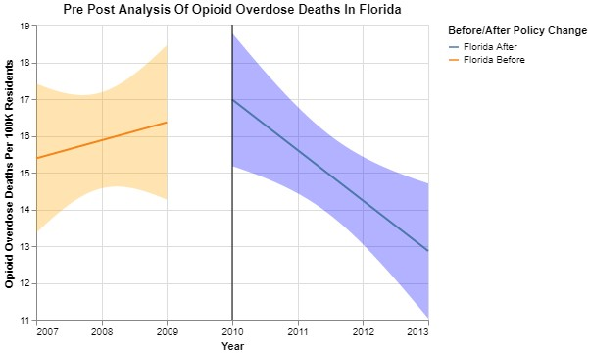
Opioid Overdose Deaths, Florida
Pre-Post Analysis

Slide 25
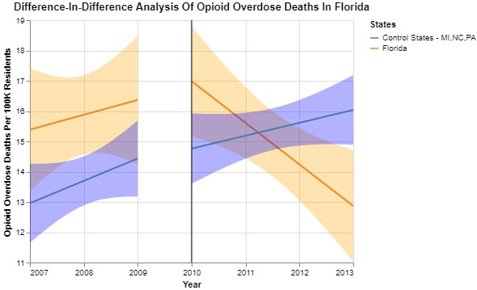
Opioid Overdose Deaths, Florida
Difference-In-Difference Analysis

Slide 26
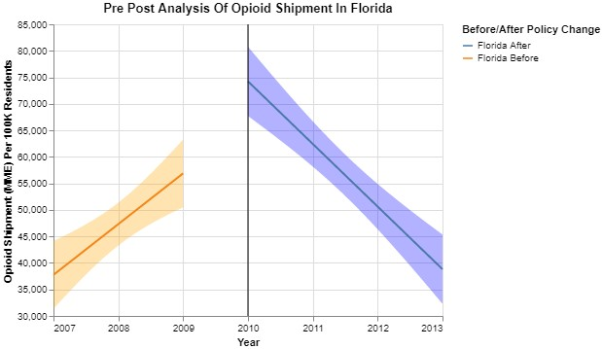
Opioid Shipment, Florida
Pre-Post Analysis

Slide 27
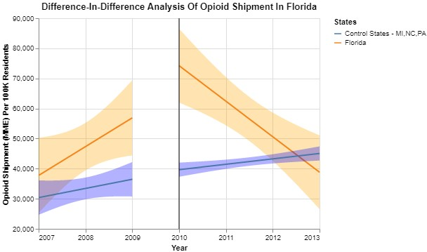
Opioid Shipment, Florida
Difference-In-Difference Analysis

Slide 28
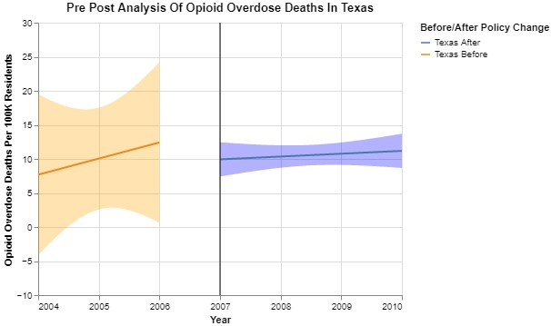
Opioid Overdose Deaths, Texas
Pre-Post Analysis

Slide 29
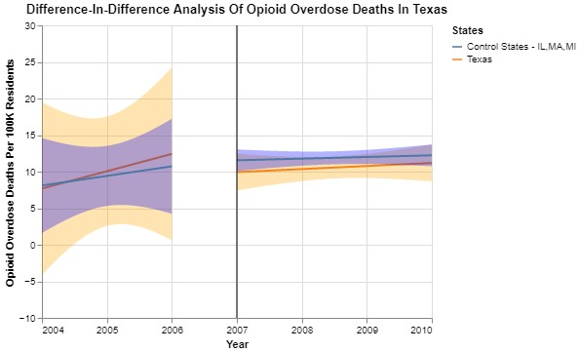
Opioid Overdose Deaths, Texas
Difference-In-Difference Analysis

Slide 30
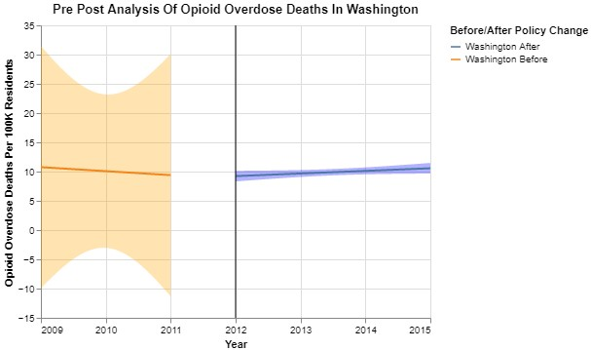
Opioid Overdose Deaths, Washington
Pre-Post Analysis

Slide 31
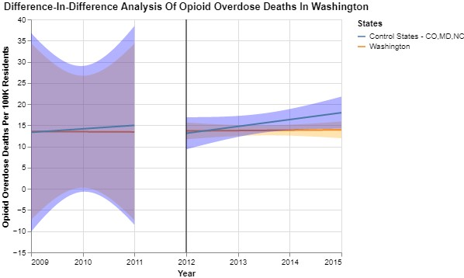
Opioid Overdose Deaths, Washington
Difference-In-Difference Analysis

Slide 32
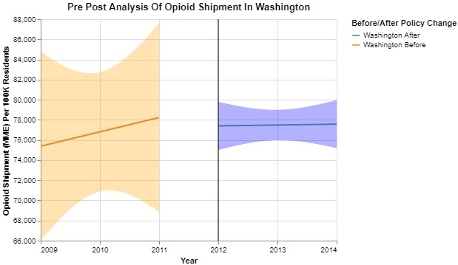
Opioid Shipment, Washington
Pre-Post Analysis

Slide 33
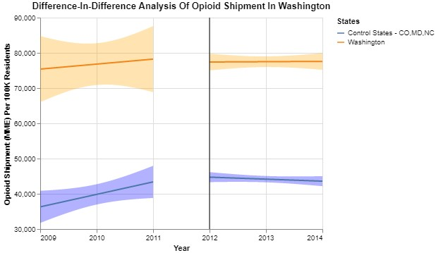
Opioid Shipment, Washington
Difference-In-Difference Analysis

Slide 34
07
Interpretation & Conclusion

Slide 35
Limitations
Observations with < 10 by county and year are not captured.
Interaction between pretest and the intervention threats internal validity in pre-post analysis.
Difference-in-difference analysis assumed treatment and control groups to be similar in every way other than the intervention. The association established in the analysis may be confounded by other factors.

Slide 36
Conclusion
FLORIDA | Effective | Effective
TEXAS | Ineffective | N/A
WASHINGTON | Ineffective | Effective
OPIOID OVERDOSE DEATHS
OPIOID SHIPMENT

Slide 37

THANK YOU!

